Slide 1
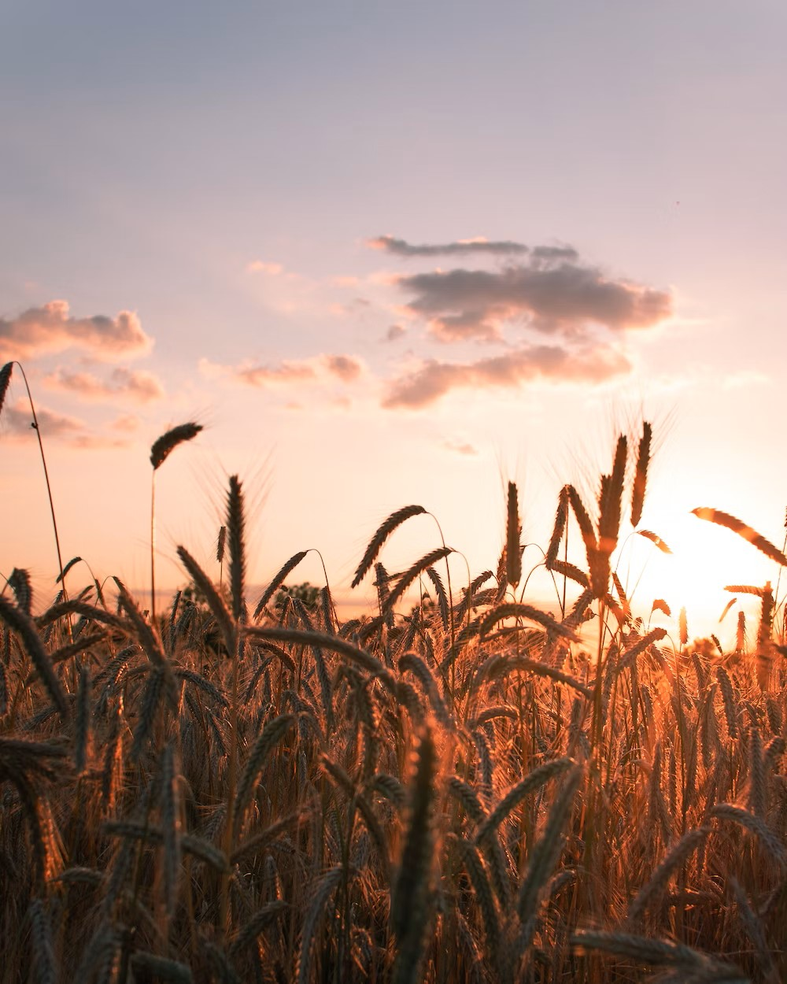
CHAT BOT FOR CROP YIELD PREDICTION AND CROP RECOMMEND USING K-NEAREST NEIGHBOUR ALGORITHM
Student name:
J. Surya RA221200504001
MTech CSE
Supervisor name:
Dr. B. Prabha B.E., M.E., PhD

Slide 2
Problem Statement
To implement a machine learning technique that can perform crop yield prediction and crop recommendation which enables farmers to optimise resource allocation and plan for potential risks.

Slide 3
Objective
The project's main objective is to implement chat bot using a machine learning algorithm for crop yield prediction and crop recommendation, enabling farmers to optimise resource allocation and plan for potential risks.

Slide 4
Abstract
Crop yield prediction and crop recommendation play a crucial role in agricultural decision-making processes, enabling farmers to optimize resource allocation and plan for potential risks. In recent years, machine learning algorithms have emerged as powerful tools for predicting crop yields accurately. This abstract focuses on the application of the KNN algorithm to train for crop yield prediction. Once the predictive model is constructed, it can be used to predict crop yields for unseen data. New input variables, such as weather forecasts or soil measurements, can be fed into the model to obtain yield predictions and crop recommendations. Random Forest, K-Nearest Neighbour, and Decision Tree models are applied for the proposed chatbot development. The comparison of the output from the three algorithms determines the accuracy of crop forecast and advice. The input data is processed through three different machine learning algorithms, and the outcome is selected by comparing the accuracy of the results obtained from each approach

Slide 5
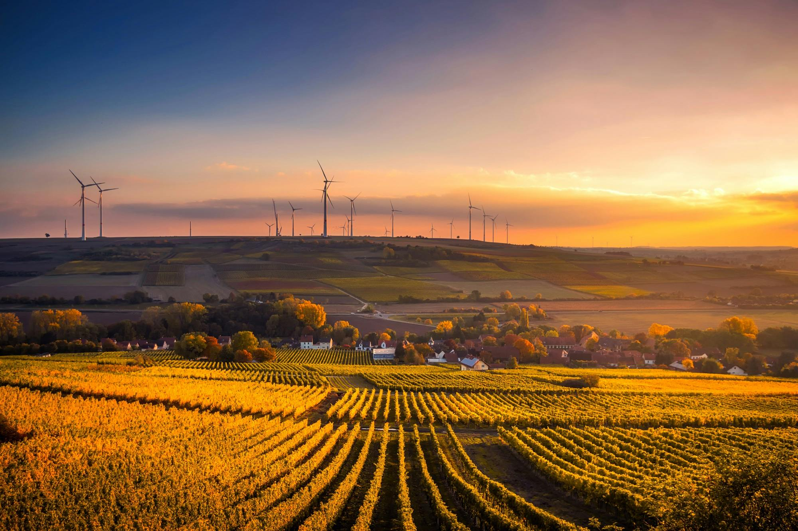
Introduction
India relies heavily on agriculture. India is the world’s largest producer of various crops but, without the use of better methods, the yield from the agricultural sector remains inadequate. Common challenges faced by Indian farmers include (i) the inability to select suitable crops based on soil properties, (ii) the inability to identify the infections developed on the leaves, and (iii) the inability to find the health of the soil. For this reason, they face a serious setback in productivity. Giving an address to this issue, crop yield prediction and crop recommendation play a crucial role in agricultural decision-making processes, enabling farmers to optimize resource allocation and plan for potential risks. Once the predictive model is constructed, it can predict crop yields for unseen data. The trained model proved advantageous in catering for the farmers with a ranked list of crops deployed along with an interface for a better user experience. The chatbot allows users to communicate by providing details, after which the model predicts the crop and responds. By providing farmers with a prioritised list of crops and an improved user interface, the trained model proved beneficial in meeting their needs. Random Forest, K-Nearest Neighbour, and Decision Tree models are applied for the proposed chatbot development. The comparison of the output from the three algorithms determines the accuracy of crop forecast and advice.

Slide 6
Literature Survey
1) Data mining of agricultural yield data: a comparison of regression models by G. Rub (2021).
Precision agriculture today refers to using advanced GPS technology in conjunction with small-scale, sensor-based crop treatment. This generates a vast amount of data, which is collected and saved for later use. Making good use of these data typically leads to substantial increases in efficiency and thus economic benefits. One of the remaining jobs is yield prediction based on available data. From the standpoint of data mining, this can be stated and addressed as a multi-dimensional regression task. This is an idea for a specific technique.
2) A real-time grading method of apples based on features extracted from defects by V Leemans (2021)
This research presents a multi-feature data integration method based on BP neural network and D-S evidential theory to increase the accuracy of apple grading, since grades based on single features, like size, shape, or colour, are not reliable. First, characteristics related to size, shape, and colour are taken out of the processed photos of apples. Second, a BP network classifier is used to classify apples based on each type of feature. The classifiers' outputs are then pooled as independent evidence to create the basic probability assignment (BPA). Ultimately, the conclusion and final grading outcome are reached by applying the D-S fusion rules of evidence. In comparison to the single feature-based approach in apple grading, the experimental results show that the decision information fusion method based on size, shape, or colour features performs well in terms of accuracy.

Slide 7
Literature Survey
Effects of CO2 and temperature on growth and yield of crops of winter wheat over four seasons by G R Bratts (2021)
In four consecutive seasons, from 1991/1992 to 1994/1995, winter wheat crops were grown in the field in Reading, UK. The crops were grown in polyethylene-covered tunnels, where a temperature gradient was imposed on a temperature variation at normal atmospheric (about 370°C) or increased [CO2] (about 700 μmol CO2 mol−1 air), creating multiple environments from a single sowing date in each season at a single location. Along the temperature gradient, the mean seasonal temperatures ranged by as much as 4°C. The length of the crop and the pace of reproductive development were unaffected by increased [CO2]. In each of the four years, the increase in mean seasonal temperature of only 1.0–2.0°C offset the gain in grain output from doubling [CO2]. Variations in environmental circumstances affected biomass partitioning and changed the roles of various yield components, resulting in year-to-year variance in responses of biomass and grain yield to [CO2] and temperature.
Predictive ability of machine learning methods for massive crop yield prediction
The precise yield estimation for the several crops included in the planning is a crucial challenge for agricultural planning. A crucial strategy for finding workable and efficient solutions to this issue is machine learning (ML). In an effort to find the best accurate method, a number of comparisons between ML techniques for yield prediction were conducted. In general, there are not enough crops and methodologies examined, and the information provided is insufficient for agricultural planning.

Slide 8
Literature Survey
In ten crop datasets, the predictive power of machine learning and linear regression algorithms is compared in this research. The approaches of multiple linear regression, k-nearest neighbor, perceptron multilayer neural networks, M5-Prime regression trees, and support vector regression were ranked. The models were validated using four accuracy metrics: correlation factor (R), normalized mean absolute error (MAE), root relative square error (RRSE), and root mean square error (RMS). The models were constructed using actual data from a Mexican irrigation zone. Two years' worth of samples were used to test the models.

Slide 9
Existing System
The mechanism of the proposed system. We compared different combinations and their accuracy rates simultaneously. We have included Decision Tree Classifier, Random Forest Classifier and KNN Classifier algorithms. The parameters we have considered constitute Country, crop_name, Year, Yield_value, Avg_rainfall, Pesticide_tonns, and Avg_temp. By comparing the metric values of every ensemble, we found the best ensemble model among all the other models considered. After determining the best ensemble model, the system is ready to create a prediction model.
Disadvantages:
There is less accuracy compared to the proposed system.
Details are given in the text box and prediction.
Have not crop recommend.

Slide 10
Proposed System
The system begins by collecting historical agricultural data, including variables such as weather conditions, soil characteristics, crop management practices, and previous yield records then suitable crops. The machine algorithms are then utilized to construct a predictive model. It partitions the data recursively, creating a tree structure where each internal node represents a decision based on a specific input variable, and each leaf node represents a predicted crop yield outcome. The integration of a Chatbot makes the crop yield prediction and crop recommendation system easily accessible and user-friendly. Farmers, researchers, or any stakeholders can interact with the Chatbot, eliminating the need for specialized technical knowledge or complex data analysis.

Slide 11
Advantage
The KNN algorithm gives more accuracy for prediction.
User interacts with Chatbot to predict forming.

Slide 12
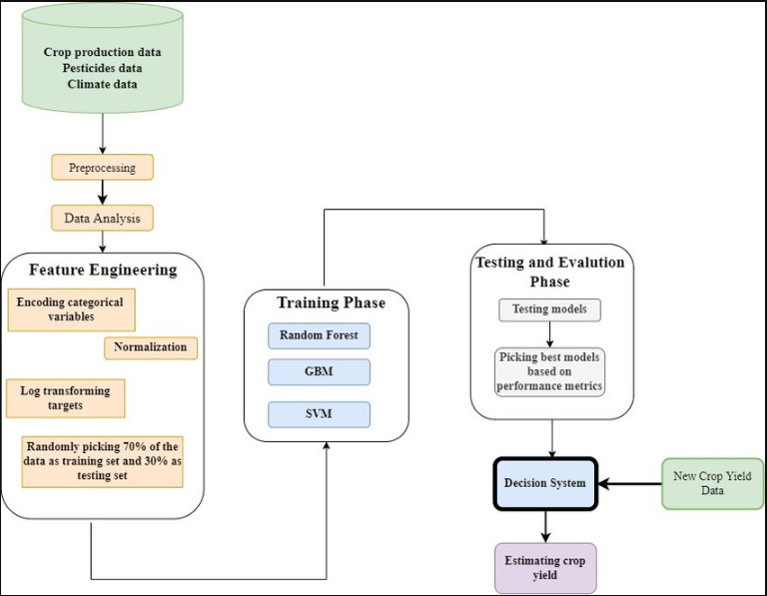
System architecture
Decision Tree
KNN

Slide 13
Module description
In a software development project, it's crucial to organize the code into modular components to enhance maintainability, reusability, and collaboration among team members. Here are some key modules for the "Chat Bot for Crop Yield Prediction and Crop Recommendation" project:
Module 1: Data Collection and Preprocessing Module
Module 2: Decision Tree Model Module
Module 3: Chat Bot Interface Module
Module 4: Crop Recommendation Module

Slide 14
Module description
Module 1: Data Collection and Preprocessing Module
This module is responsible for collecting, cleaning, and preprocessing data from various sources, including crop yield data, soil data, and weather data. It includes submodules like:
Data Scraper: Collects data from external sources.
Data Cleaner: Handles missing values and data quality issues.
Feature Engineer: Extracts relevant features from the collected data.
Data Integrator: Combines data from different sources into a unified dataset.

Slide 15
Module description
Module 2: KNN Model Module
This module focuses on developing, training, and evaluating the KNN models for crop yield prediction. It includes submodules like:
Model Trainer: Trains KNN models on the prepared dataset.
Model Evaluator: Measures the model's performance using appropriate metrics.
Model Tuner: Fine-tunes the model's hyperparameters for better accuracy.

Slide 16
Module description
Module 3: Chat Bot Interface Module
This module deals with the user interface of the chat bot, enabling users to interact with the system. It includes submodules like:
User Input Processor: Handles user queries and extracts relevant information.
NLP (Natural Language Processing): Understands and interprets user messages.
Chat Bot Logic: Contains the core logic for responding to user queries and providing predictions and recommendations.
Visualizer: Generates graphs, charts, or visual aids for better user understanding.

Slide 17
Module description
Module 4: Crop Recommendation Module
This module is responsible for suggesting suitable crops to users based on the decision tree predictions and environmental factors. It includes submodules like:
Recommendation Algorithm: Implements the logic for crop recommendations.
Customization Options: Allows users to customize recommendations based on their preferences.
Crop Database: Stores information about various crops and their characteristics.

Slide 18

Hardware requirements
Processor - i5
Speed - 3 GHz
RAM - 8 GB(min)
Hard Disk - 500 GB
Key Board - Standard Windows Keyboard
Mouse - Two or Three Button Mouse
Monitor - SVGA

Slide 19

Software requirements
Operating System: Linux, Windows/7/10
Tools: Anaconda, Jupiter, vs code
Front End: HTML, CSS
Server-side Script: Python, AIML

Slide 20
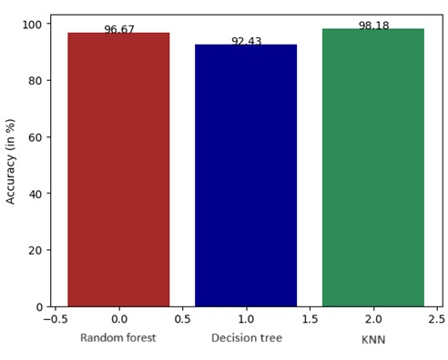
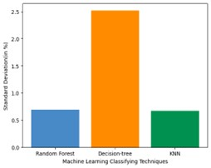
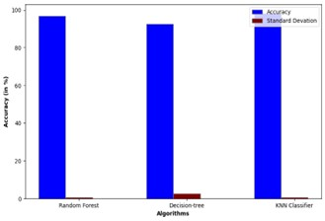
Experimental Result
Comparative Result:

Slide 21
Output

Slide 22
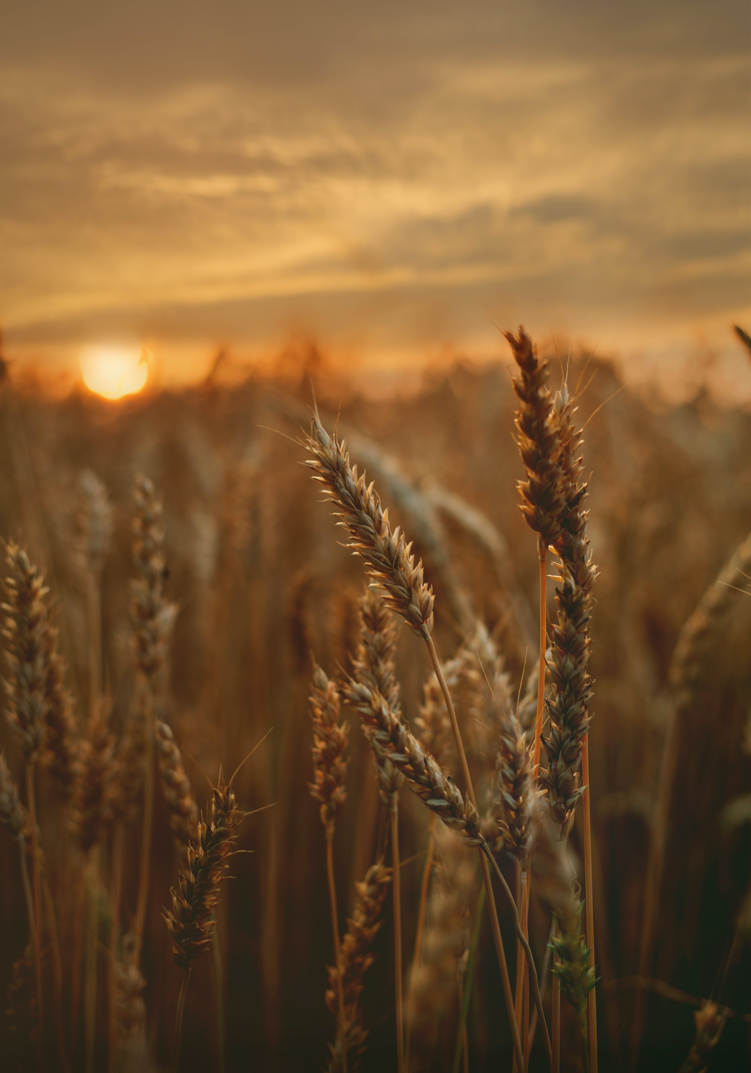
Conclusion
The development of the "Chat Bot for Crop Yield Prediction and Crop Recommendation" project represents a significant advancement in leveraging technology to assist farmers in making informed decisions about crop selection and cultivation practices. Through a systematic methodology and well-structured modular design, this project aims to provide valuable support to the agricultural community.

Slide 23
Reference
[1] Lai J.Y., Sowmya A., Trinder J., (2005). Support vector machine experiments for road recognition in high resolution images, Machine Learning and Data Mining in Pattern Recognition, 4th International Conference, MLDM 2005, Leipzig, Germany, July 9-11, 2005.
[2] Batts G.R., (1997). Effects of co2 and temperature on growth and yield of crops of winter wheat over four seasons, journal ISSN:1161-0301.
[3] Rub G., (2009). Data mining of agricultural yield data: a comparison of regression models, Advances in Data Mining. Applications and Theoretical Aspects, 9th Industrial Conference, ICDM 2009, Leipzig, Germany, July 20-22, 2009.
[4] Jorquera, H., JR Pérez-Correa, A. Cipriano, and G. Acuña, (2001). Short Term Forecasting of Air Pollution Episodes, in Environmental Modeling (vol. 4), P. Zannetti (ed.), WIT Press.
[5] Leemans V., (2004). a real time grading method of apples based on features extracted from defects, Journal of Food Engineering 61(1).

Slide 24
[6] H.S. Jayanna, S.R.M Prasanna, (2009). analysis, feature extraction, modeling and testing techniques for speaker recognition, IETE Technical Review 26(3).
[7] Alberto González-Sanchez, (2014). predictive ability of machine learning methods for massive crop yield prediction, Spanish Journal of Agricultural Research 2014 12(2): 313-328.
[8] Mandic D. P., (2001). recurrent neural networks for prediction: learning algorithms, architectures and stability, ISBN: 978-0-471-49517-8.
[9] Hochreiter S., (1997). long short-term memory. neural computation, Neural Computation 9(8):1735-80.
[10] H. Sak, F. Beaufays, (2014). long short-term memory recurrent neural network architectures for large scale acoustic modelling, arXiv:1402.1128 [cs.NE].
[11] Wiener M., Andy Liaw, (2002). classification and regression by randomforest, R News, 2 (3): 18--22 (2002).
[12] Kumar, Y. J. N., Spandana, V., Vaishnavi, V. S., Neha, K., & Devi, V. G. R. R. (2020). Supervised Machine learning Approach for Crop Yield Prediction in Agriculture Sector. In 2020 5th International Conference on Communication and Electronics Systems (ICCES) (pp. 736-741). IEEE.

Slide 25
[13] Liakos, K. G., Busato, P., Moshou, D., Pearson, S., & Bochtis, D. (2018). Machine learning in agriculture: A review. Sensors, 18(8), 2674.
[14] Chandgude, A., Harpale, N., Jadhav, D., Pawar, P., & Patil, S. M. (2018). A Review on Machine Learning Algorithm Used For Crop Monitoring System in Agriculture. International Research Journal of Engineering and Technology (IRJET), 5(04), 1470.
[15] Patil, A., Kokate, S., Patil, P., Panpatil, V., & Sapkal, R. (2020). Crop Prediction using Machine Learning Algorithms. International Journal of Advancements in Engineering & Technology, 1(1), 1-8.
[16] Khaki, S., & Wang, L. (2019). Crop yield prediction using deep neural networks. Frontiers in plant science, 10, 621.
[17] Batts G. R. (2021). Support vector machine experiments for road recognition in high resolution images.

